Slide 1
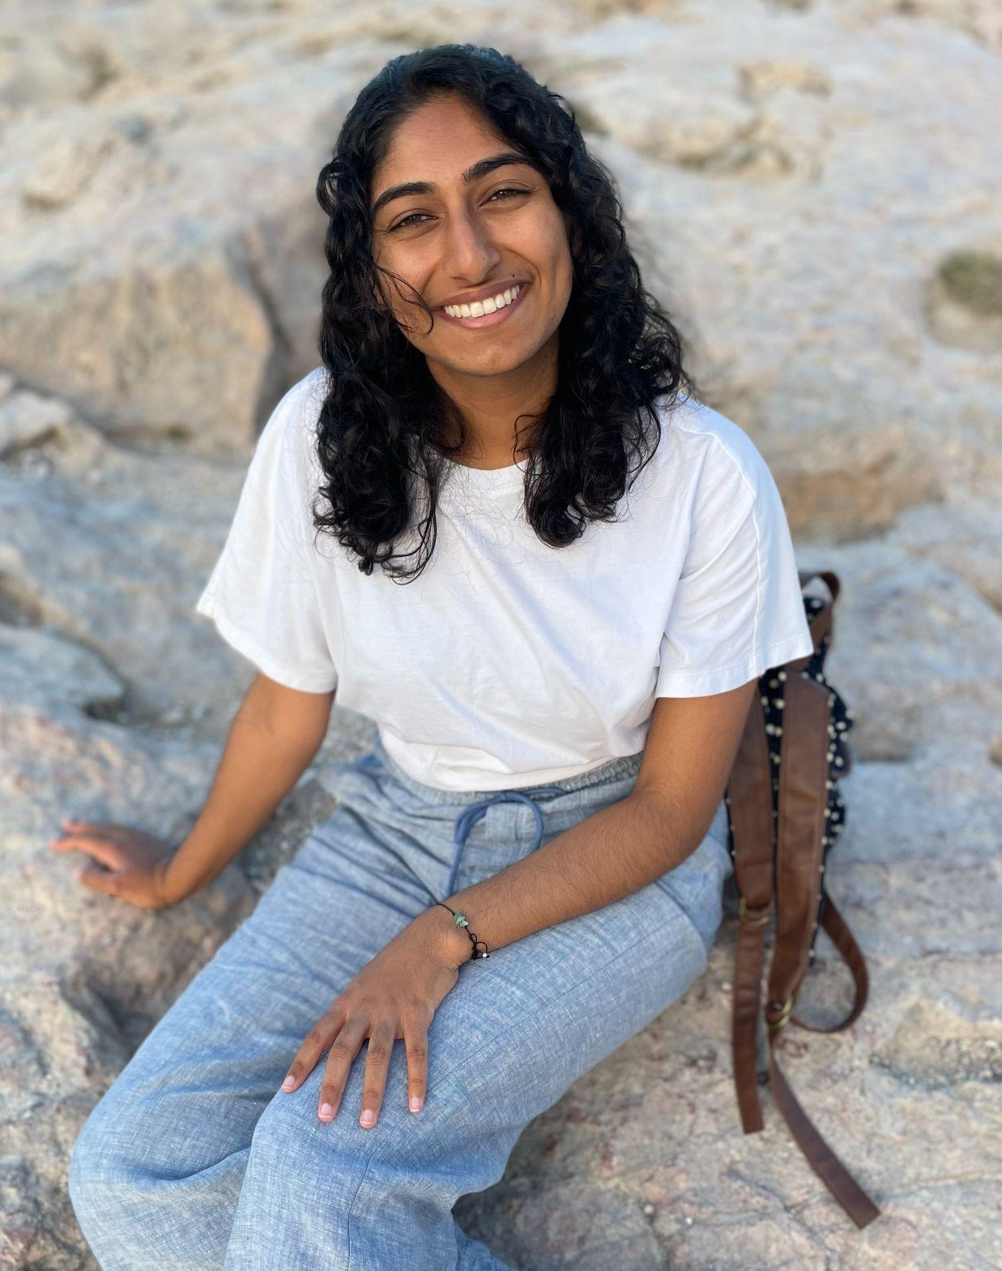
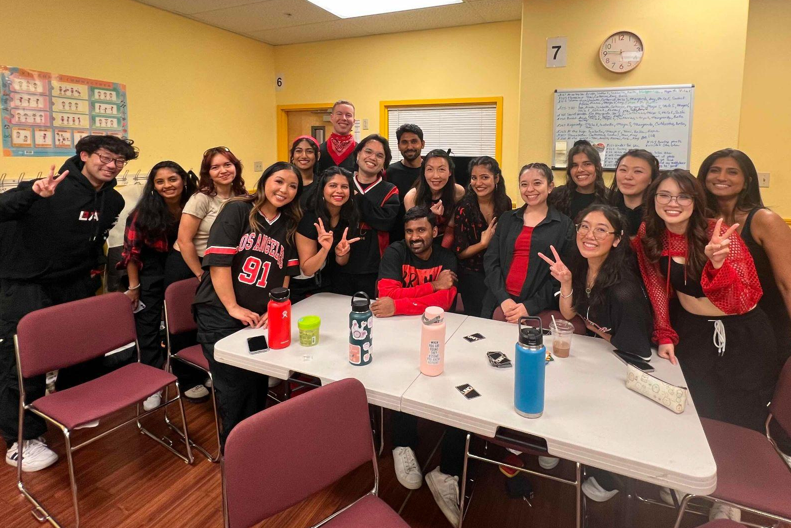
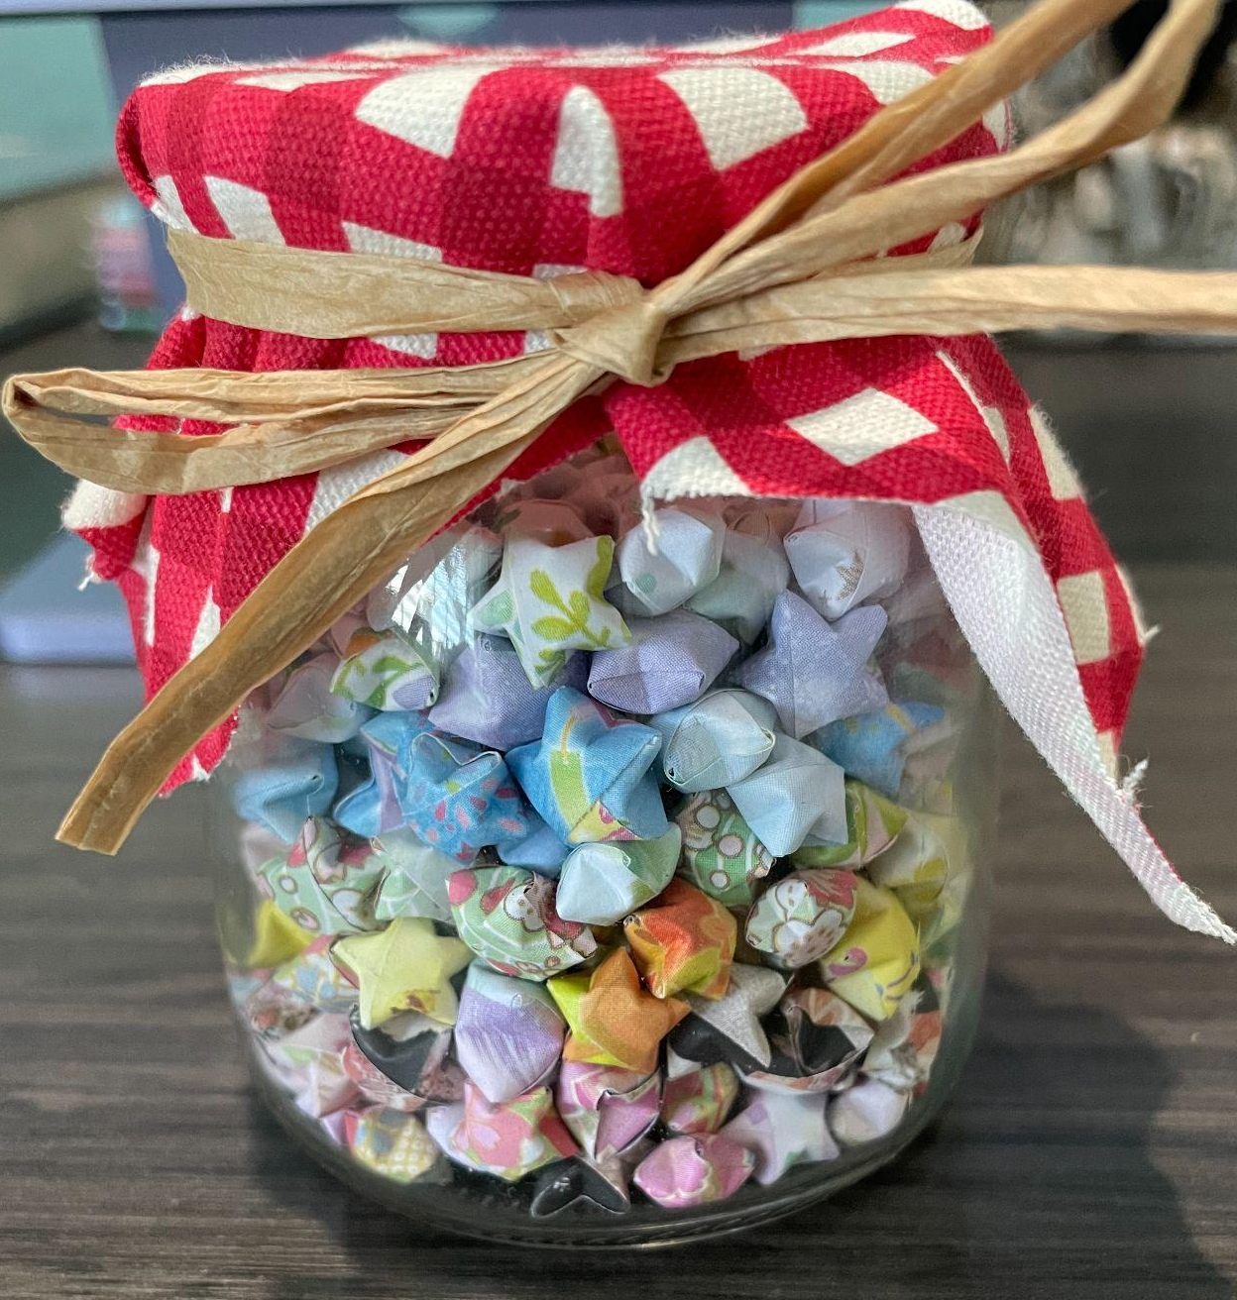
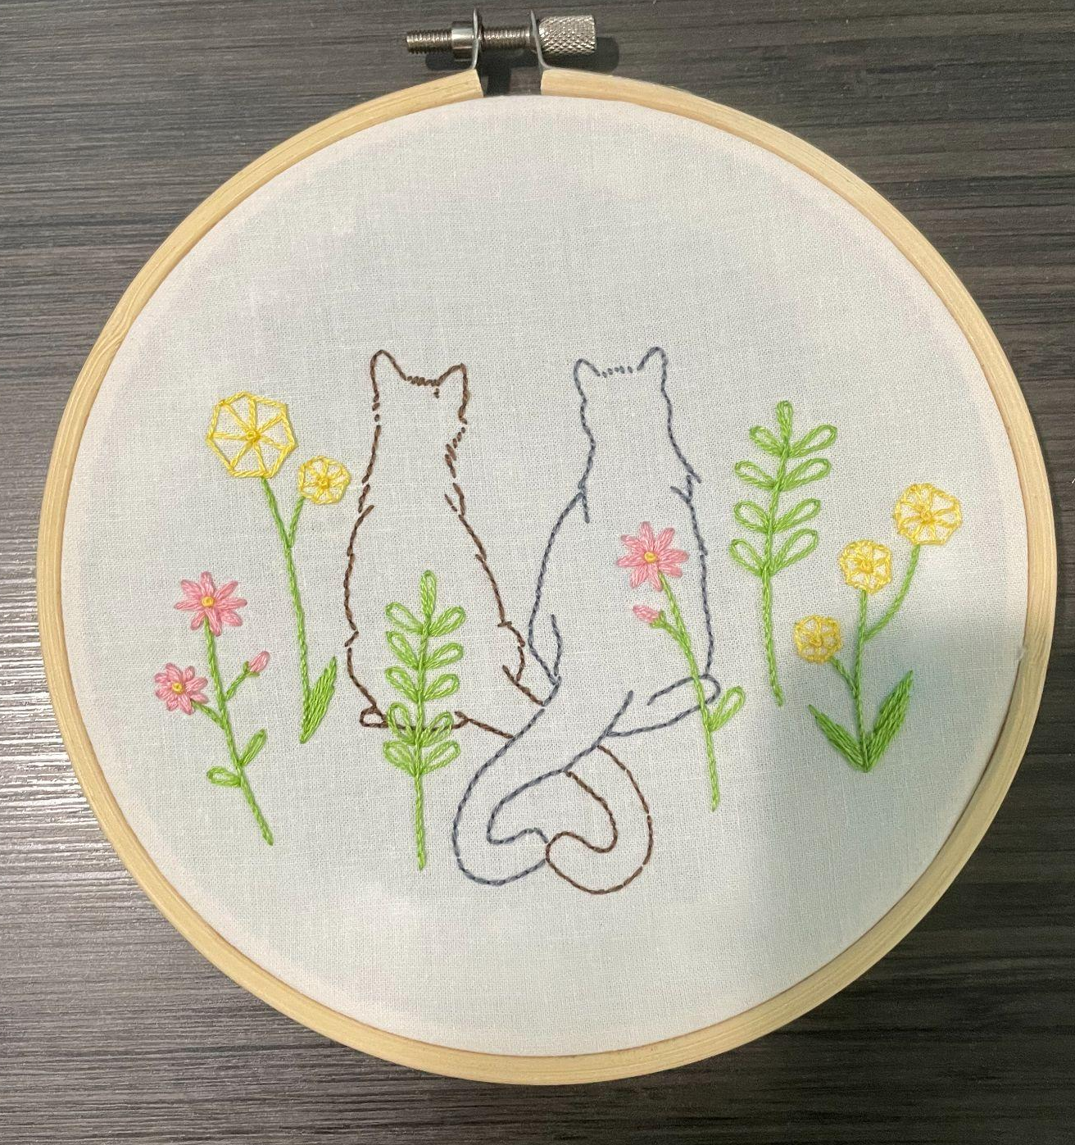
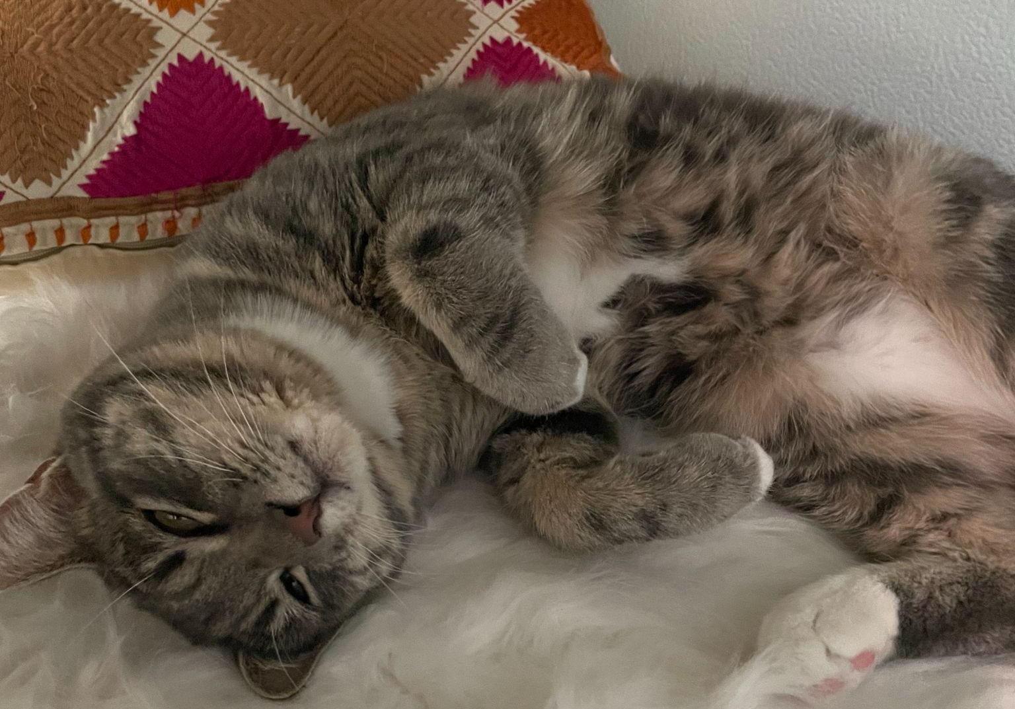
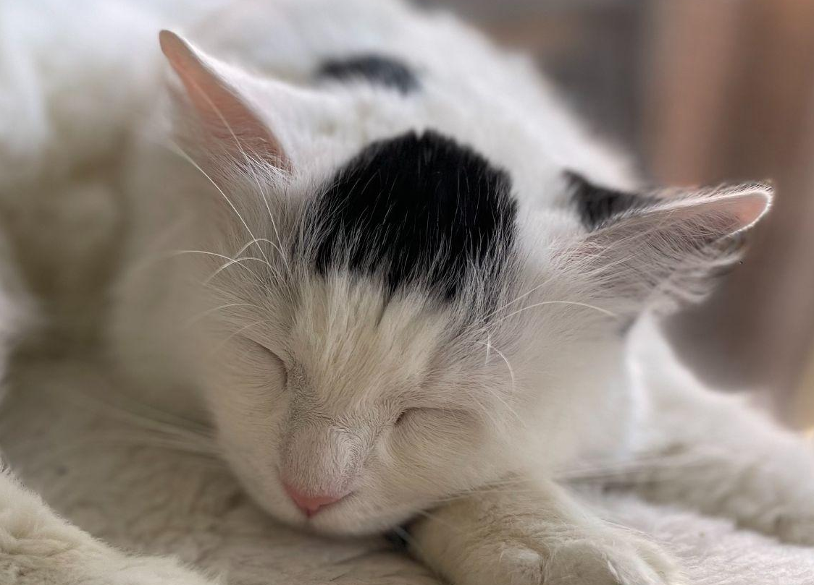
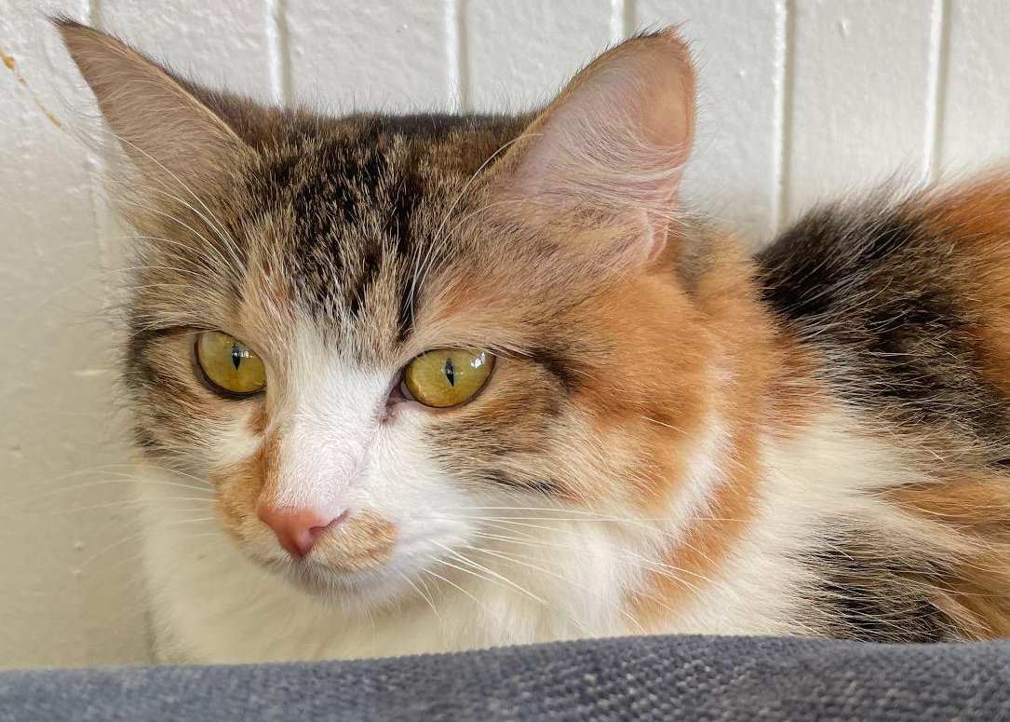
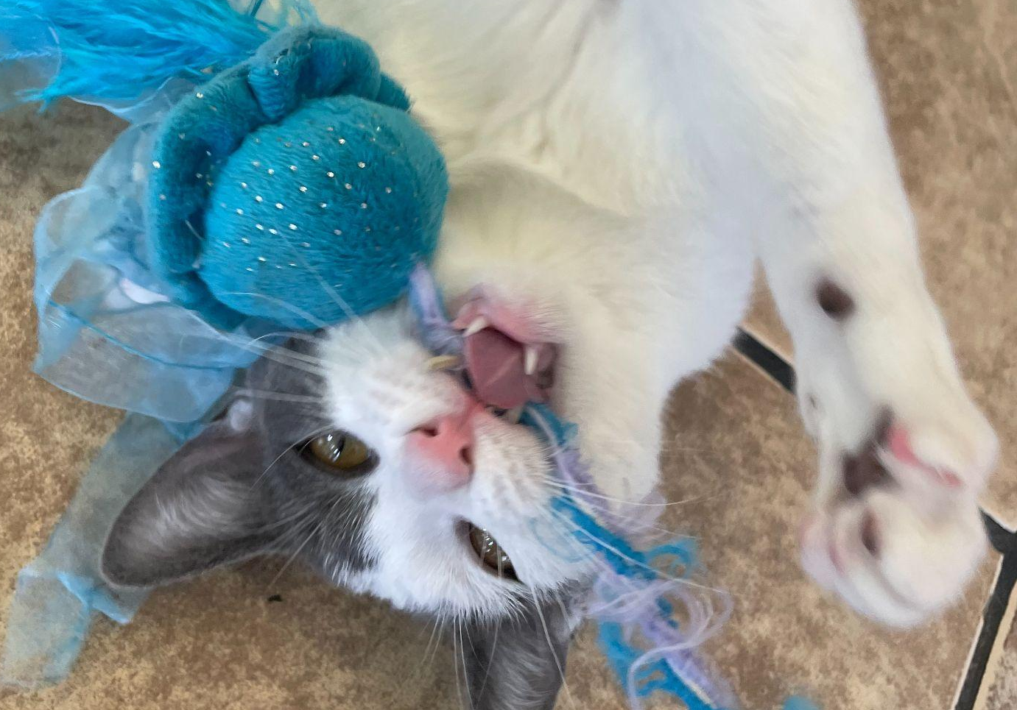
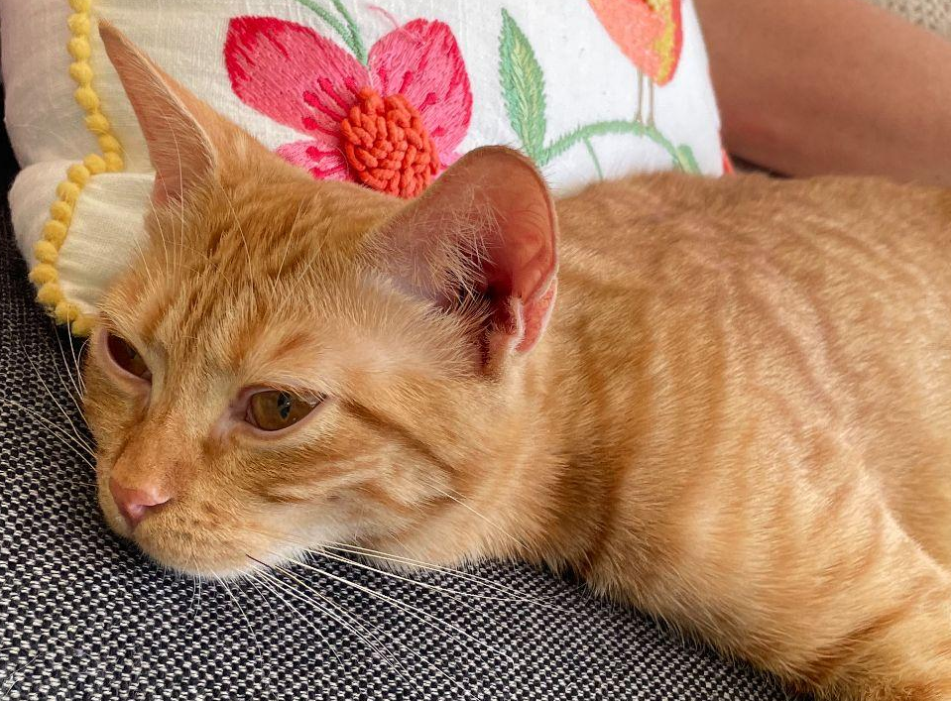
Radha Ganesh
My mentor is Dr. Barbara Novak, and my project is about identifying best practices for deduplication of bulk RNAseq datasets both with and without Unique Molecular Identifiers (UMIs).
I graduated from San Jose State University with a Bachelor’s in Computer Science
In my free time, I love dancing, crafting, going to cafes, and volunteering at a cat shelter.
my dance team
my latest craft projects
some of the cats I volunteer with

